Slide 1


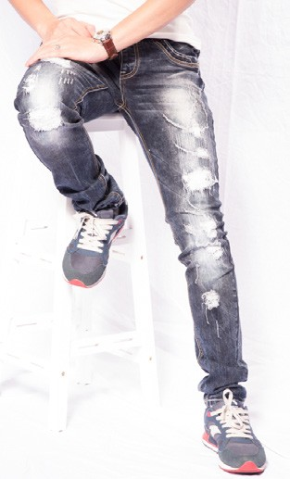
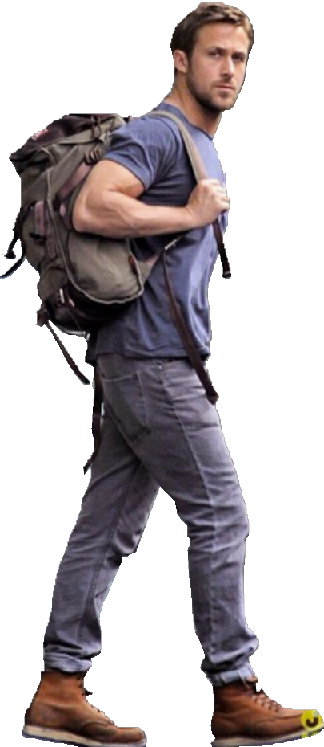

FACTORY RATE पे JEANS ख़रीदे।
KMP SOLUTIONS . “GARMENTS SOLUTIONS”
FACTORY OUTLET
MEN’S , FEMME
BOYS, GIRLS
JEANS ,TROUSER,
T-SHIRT, SHIRT
DENIM JACKETS
Mr. Raju Kushwaha
Mob. No.:- +91-8687964330
Ram Bhawan Chuaraha, Kaundhiyara, Prayagraj
Mr. Vijay Kushwaha Mob No. +91-9716501795
Mayapri Industrial Area New Delhi

